Slide 1
VASCULITIS ( Part 1)
Mustafa E. Al-Badran
CABM FIBMS
Internist & Rheumatologist

Slide 2
VASCULITIS
A disorders characterised by inflammation and necrosis of blood vessel walls, with damage to
Skin
Kidney
Lung
Heart
Brain
GIT

Slide 3
The spectrum of these disorders ranging from
Mild and transient disease affecting only the skin
Life-threatening fulminant disease with multiple organ failure

Slide 4
Notes:
Chapel Hill classification 2012

Slide 5
Cryoglobulinaemic Vasculitis
Small-vessel vasculitis that occurs when Igs precipitate out in the cold
Cryoglobulins are classified into three types
Types II and III are associated with vasculitis (Hepatitis B &C infection and Autoimmune diseases)
Clinical Features
Vasculitic rash over the lower limbs
Arthralgia
Raynaud’s phenomenon
Neuropathy
Treatment
Patients with hepatitis B and C infection→ Treat Hepatitis B &C
In the abscece of Hepatitis B & C →Glucocorticoids & immunosuppressive therapy (used empirically)
In severe cases→ Plasmapheresis

Slide 6
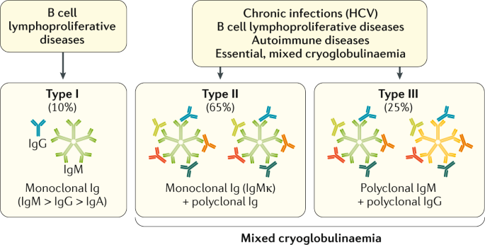

Slide 7
Henoch–Schönlein Purpura
A small-vessel vasculitis caused by immune complex deposition following an infectious trigger
It is predominantly a disease of children and young adults

Slide 8
Clinical Features
Purpura
Abdominal pain
Gastrointestinal bleeding
Arthralgia
Over the buttocks and lower legs
Nephritis can also occur and may present up to 4 weeks after the onset of other symptoms

Slide 9
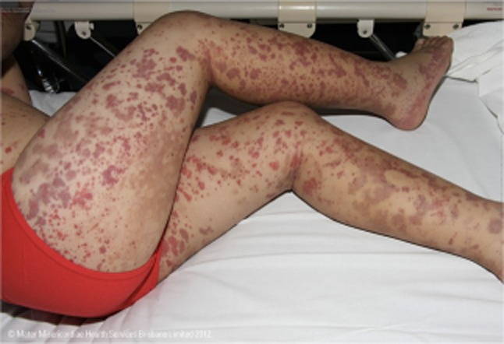
Typical Purpura of the lower limbs and buttocks

Slide 10
Diagnosis
Biopsy of affected tissue shows a vasculitis with IgA deposits in the vessel wall
Treatment
HSP is self-limiting disorder that resolve spontaneously without specific treatment
Severe disease(Nephritis)
Glucocorticoids and immunosuppressive

Slide 11
Antineutrophil cytoplasmic antibody associated vasculitis (AAV)
A life-threatening disorder characterised by
Inflammatory infiltration of small blood vessels
Fibrinoid necrosis
The presence of circulating antibodies to Antineutrophil cytoplasmic antibody (ANCA)

Slide 12
Subtypes of ANCA associated vasculitis
Granulomatosis with Polyangiitis
Eosinophilic Granulomatosis with Polyangiitis
Microscopic Polyangiitis

Slide 13
Granulomatosis with Polyangiitis*
GPA is a primary vasculitis characterized by
Upper and lower respiratory tract involvement with granulomatous vasculitis
Glomerulonephritis (GN) that is pauci-immune, focal and segmental, necrotizing, and often crescentic
Strong association with c-ANCA and anti-PR3 antibodies
*Previously known as Wegener’s granulomatosis

Slide 14
Dr. Friedrich Wegener 1907-1990 German pathologist
Notes:
German pathologist who is notable for his description of a rare disease originally referred to Wegener disease and now referred to as granulomatosis with polyangiitis.
Although this disease was known before Wegener's description, from the 1950s onwards it was generally referred to as Wegener's granulomatosis.
The American College of Chest Physicians (ACCP) awarded Wegener a “master clinician” prize in 1989.
After his Nazi past was discovered in 2000, the ACCP rescinded the prize and campaigned to rename Wegener's granulomatosis to ANCA-associated granulomatous vasculitis.
More recently, several professional societies, including the American College of Rheumatology, the European League Against Rheumatism, and the American Society of Nephrology, proposed the name 'granulomatosis with polyangiitis' in a 2011 editorial.

Slide 15
Generalized GPA
Lungs
Kidneys
Limited GPA
Absence of renal involvement
Present as a granulomatous disorder without vasculitic features
Only 10% of cases evolve to generalize GPA
Involvement of all three major anatomic sites
Upper respiratory tract
Notes:
(a more strict definition also excludes patients with pulmonary hemorrhage, orbital pseudotumor, progressive neuropathy, and central nervous system [CNS] disease).

Slide 16
Clinical Features
Upper Respiratory tract involvement
Epistaxis
Nasal crusting (Untreated nasal disease leads to destruction of bone and cartilage)
Sinusitis
Deafness due to inner ear involvement
Lower respiratory tract involvements
Haemoptysis
Mucosal ulceration
Migratory pulmonary infiltrates and nodules (50%)
Glomerulonephritis

Slide 17
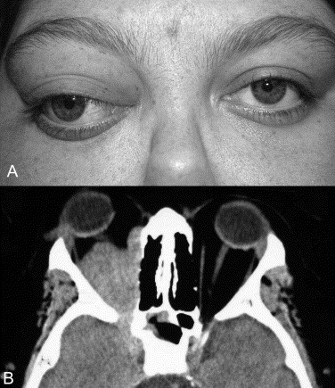
Proptosis because of inflammation of the retro-orbital tissue causes
Diplopia due to entrapment of the extra-ocular muscles
Loss of vision due to optic nerve compression
Notes:
Disturbance of Colour vision is an early feature of optic nerve compression.

Slide 18
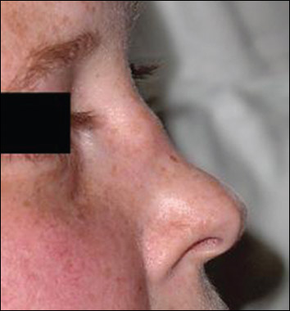
Saddle Nose deformity

Slide 19
Notes:
Saddle nose is a condition associated with nasal trauma, congenital syphilis, relapsing polychondritis, granulomatosis with polyangiitis, cocaine abuse, and leprosy, among other conditions. The most common cause is nasal trauma. It is characterized by a loss of height of the nose, because of the collapse of the bridge

Slide 20
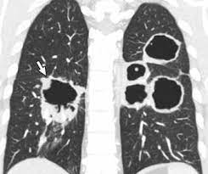
Multiple cavitation in patient with GPA

Slide 21
Investigations
Patients with active disease usually have
Leukocytosis with elevated CRP, ESR and PR3
Complement levels are usually normal
Imaging of the upper airways or chest with MRI can be useful in localizing abnormalities
Definite diagnosis by biopsy from the Lung, kidney or lesions in the sinuses and upper airways

Slide 22
Management
Organ-threatening or acute–severe disease
High-dose glucocorticoids (Pulse I.V methylprednisolone 0.5–1 g for 3 days, then oral prednisolone 0.5 mg/kg) + Cyclophosphamide I.V (e.g. 0.5–1 g every 2 weeks for 3 months) Followed by maintenance therapy with lower-dose glucocorticoids and Azathioprine, Methotrexate or MMF.
Rituximab in combination with high-dose glucocorticoids is equally effective as oral cyclophosphamide at inducing remission in AAV.
Limited AAV
Combination of Glucocorticoids and Methotrexate

Slide 23
Plasmapheresis considered for
Fulminant lung disease (Pulmonary Haemorrhage)
Rapidly progressive Glomerulonephritis (Crescentic GN)

Slide 24
Follow up
AAV has a tendency to relapse and patients must be followed on a regular and long-term basis monitoring
Urinalysis for blood and protein
Creatinine
Inflammatory markers
Lung function
C-ANCA
ABs

Slide 25
Microscopic Polyangiitis
Necrotising small-vessel vasculitis present with
Rapidly progressive glomerulonephritis
Alveolar haemorrhage
Cutaneous and gastrointestinal involvement is common and other features include neuropathy (15%) and pleural effusions (15%)
Patients are usually myeloperoxidase (MPO) antibody-positive

Slide 26
Eosinophilic Granulomatosis with Polyangiitis*
A small-vessel vasculitis with an incidence of about 1 per 1 000 000
Some patients have a prodromal period for many years, characterised by allergic rhinitis, nasal polyposis and late-onset asthma that is often difficult to control
* Previously called Churg–Strauss syndrome

Slide 27
The typical acute presentation is with a triad of
Skin Lesions (purpura or nodules)
Asymmetric Mononeuritis Multiplex
Eosinophilia
Pulmonary Infiltrates and Pleural or Pericardial Effusions (Serositis)
Mesenteric Vasculitis (50%)
Other features

Slide 28
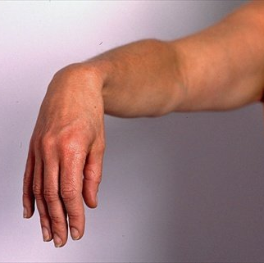

Slide 29
Investigations
Patients with active disease have
Raised ESR and CRP
Eosinophilia
Antibodies to MPO or PR3 detected in up to 60% of cases
Biopsy of an affected site reveals a small-vessel vasculitis with eosinophilic infiltration of the vessel wall

Slide 30
Management
High-dose Glucocorticoids & Cyclophosphamide, followed by maintenance therapy with low-dose Glucocorticoids and Azathioprine, Methotrexate or MMF

Slide 31
Medium Size Vasculitis
Polyarteritis Nodosa
Kawasaki disease

Slide 32
Polyarteritis Nodosa
Peak incidence between of 40 and 50 with male-to-female ratio of 2 :1
Risk factor Hepatitis B
Presentation is with fever, myalgia, arthralgia and weight loss
The most common skin lesions are
Palpable Purpura
Ulceration
Infarction
Livedo Reticularis
Neuropathy, which is typically symmetrical and affects both sensory and motor nerves in 70% of patient due arteritis of the vasa nervorum
Severe hypertension and/or renal impairment may occur due to multiple renal infarctions but glomerulonephritis is rare (in contrast to microscopic polyangiitis)

Slide 33
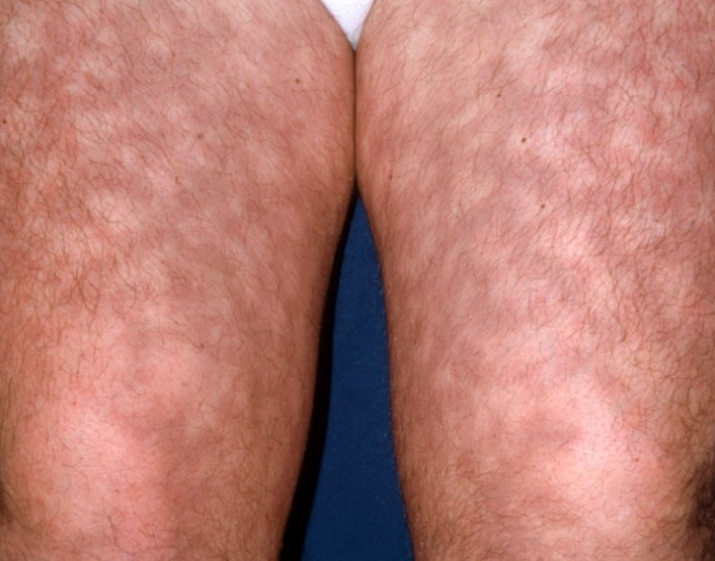
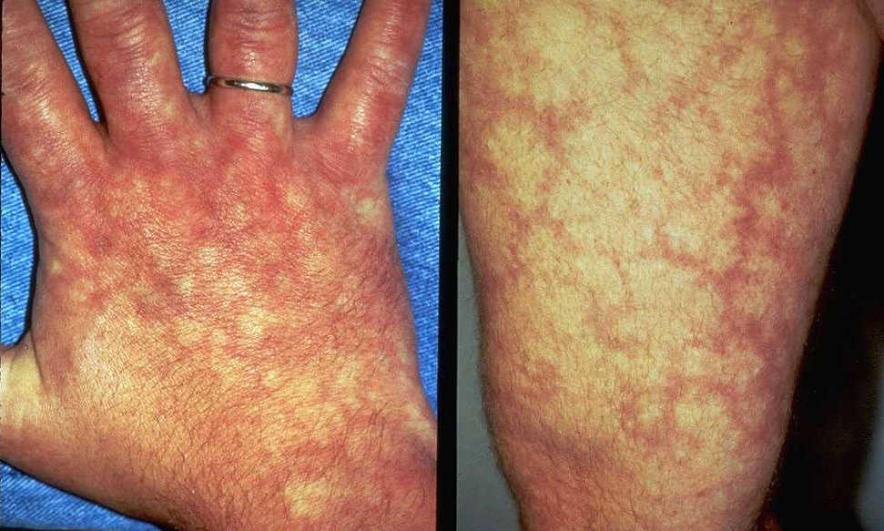
Livedo reticularis
Notes:
Livedo reticularis (LR) is a skin symptom. It refers to a netlike pattern of reddish-blue skin discoloration. The legs are often affected. The condition is linked to swollen blood vessels. It may get worse when the temperature is cold.

Slide 34
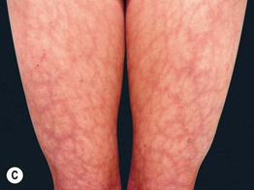

Slide 35
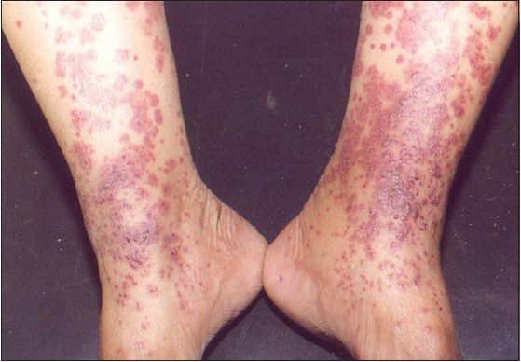
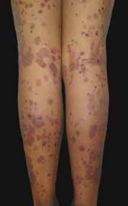
Palpable Purpura

Slide 36
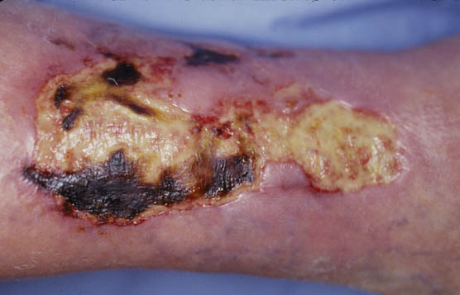
Ulcer

Slide 37
Magnetic resonance angiography
Treatment
Diagnosis
Muscle or sural nerve biopsy
High-dose glucocorticoids and immunosuppressants, as for ANCA-associated vasculitis
Multiple aneurysms & smooth narrowing of mesenteric, hepatic or renal systems
Necrotising inflammation and vessel occlusion

Slide 38
Magnetic Resonance Angiography shows Multiple Aneurysms & Smooth Narrowing of right kidney

Slide 39
Kawasaki disease
Self-limiting vasculitis affecting children under 5 years mainly in Japan, China and Korea present with
Generalised rash, including palms and soles (Polymorphous rash)
Inflamed oral mucosa (Mucositis(
Conjunctival injection (Non-exudative conjunctivitis in both eyes)
Cardiovascular complications include
Coronary arteritis, leading to myocardial infarction, transient coronary dilatation (Aneurysms)
Myocarditis
Pericarditis
Peripheral vascular insufficiency and gangrene
Treatment :Aspirin (5 mg/kg daily for 14 days) & IVIg (400 mg/kg daily for 4 days)
Fever & Cervical lymphadenopathy

Slide 41
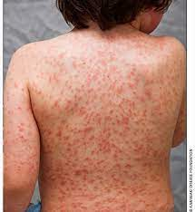
Straw Berry Tongue & The Morbilliform Rash

Slide 42
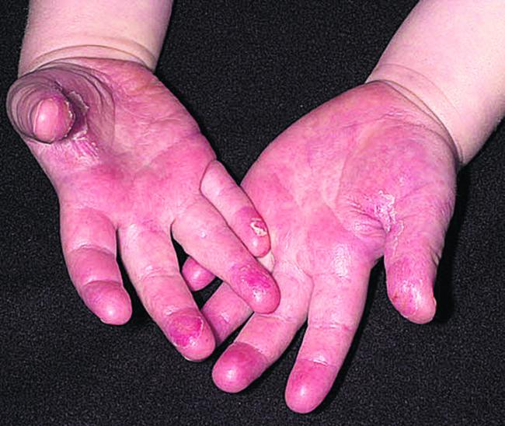
Conjunctivitis & Hand Involvement

Slide 43
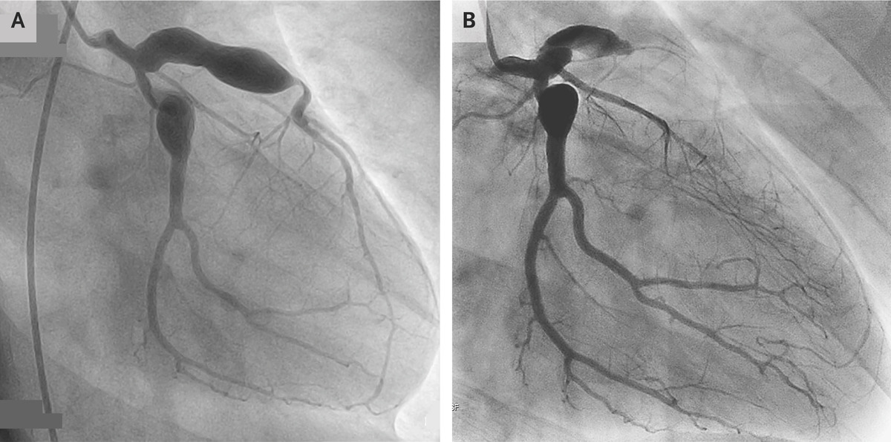
Giant coronary artery aneurysms of the right coronary and left anterior descending arteries
The New England Journal of Medicine 2018 ©

Slide 44
Large Vessel Vasculitis
Takayasu Arteritis
Giant Cell Arteritis & Polymyalgia Rheumatica

Slide 45
Takayasu arteritis
Large vessels arteritis affects the aorta, its major branches and occasionally the pulmonary arteries
The typical age at onset is 25–30 years, with an 8 : 1 female-to-male ratio, most common in Asia
It is characterised by granulomatous inflammation of the vessel wall, leading to occlusion or weakening

Slide 46
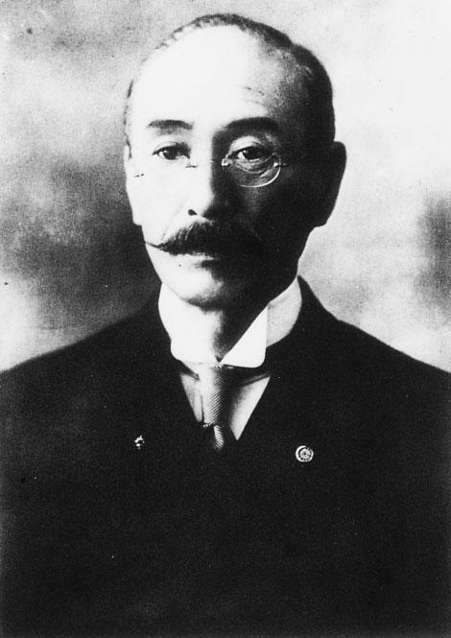
Mikito Takayasu (1860 - 1938) Japanese ophthalmologist

Slide 47
CLINICAL FEATURES
Symptoms
Claudication
Fever
Arthralgia
Weight loss
Signs
Loss of pulses
Bruits
Hypertension
Aortic incompetence

Slide 48
Diagnosis
By angiography, which reveals coarctation, occlusion &aneurysmal dilatation
Treatment
High-dose glucocorticoids and immunosuppressants, as described for anca-associated vasculitis

Slide 49
